Slide 1


London Funders
Current context of covid-19, and anticipating future needs
Sherry Peck
CEO
sherrylynpeck@saferlondon.org.uk
www.saferlondon.org.uk

Slide 2

Agenda
8th June 2020
  Safer London:
  A little bit about what we do
  Some Headlines from our work
  Drivers of violence, adverse childhood experiences and adverse community environment and the current context
  Discussion

Slide 3
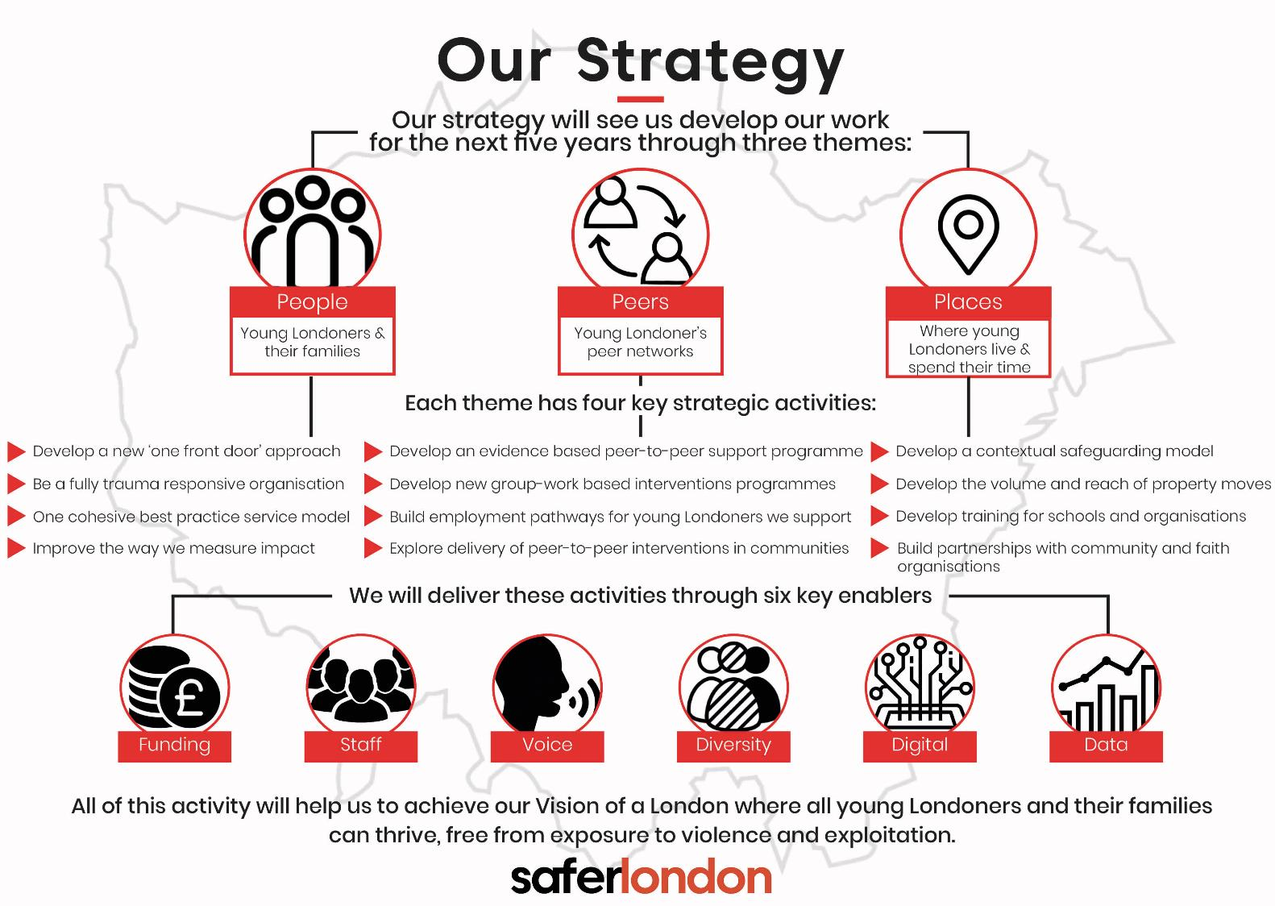
  www.saferlondon.org.uk/our-strategy

Slide 4




Safer London
A little bit about what we do
We work in every London borough, supporting young Londoners, their families, peers and communities affected by violence and exploitation.
PEOPLE
PEERS
PLACES
We’ll provide trusted, individual, relational support to ensure more young Londoners will feel safer, be safer, and have positive futures.
We’ll enable young Londoners to support
and be supported by
their peers.
We’ll work directly in the
community to ensure that the places and spaces where young Londoners spend their time
are safe and positive.

Slide 5
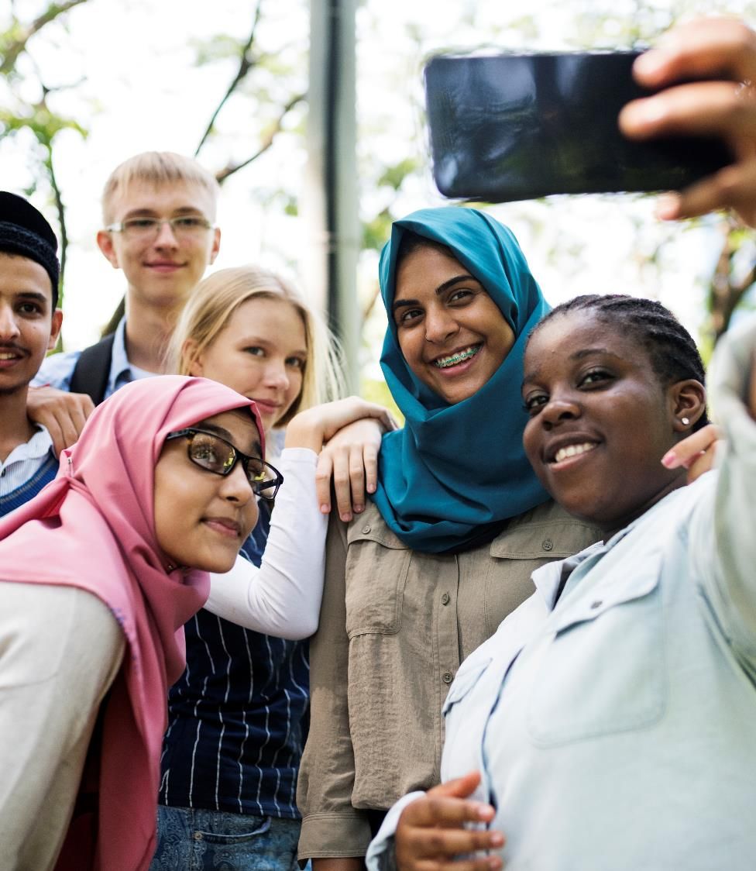
Some headlines from our work
  We are seeing various forms of exploitation and circumstances where young Londoners are affected by violence and exploitation – sexual, criminal, weapons storage, labour or cuckooing etc.
  ‘Safety’ can be impacted by a number of factors – individual resilience, place, resources, development stage, peer group….
  As a country we cannot police our way out of this crisis - It’s a complex issue that needs a multi-agency, long term, non-politicised response

Slide 6

Some headlines from our work
  Recognised (both within our work and in research) some key themes:
  Victim/Perpetrator divide unhelpful and often non-existent (A review of our case files of one service demonstrates that 100% have been victims of ACE and/or abuse in adolescent)
  Peers have massive influence – normalizing and coercing
  Relationships are key
  Impact of Adolescent development and toxic environment massively under estimated – never more so than now

Slide 7
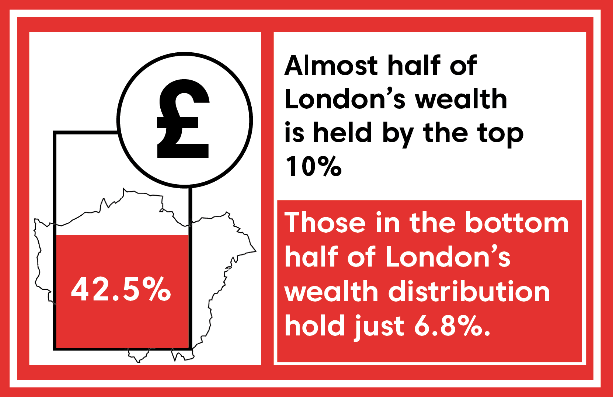

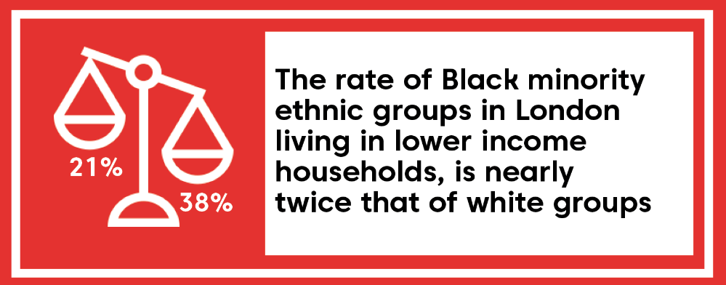
Inequality
Wealthy
36%
20%
Middle
37%
65%
27%
Poor
15%
2010
1980
Notes:
1. London Poverty Profile April 2020
https://trustforlondon.fra1.digitaloceanspaces.com/media/documents/Londons_Poverty_Profile_2020.pdf
2. Ethnic Inequalities in London March 2016
https://trustforlondon.fra1.digitaloceanspaces.com/media/documents/London-Inequality-report-v3.pdf
3. London Poverty Profile April 2020
https://trustforlondon.fra1.digitaloceanspaces.com/media/documents/Londons_Poverty_Profile_2020.pdf

Slide 8
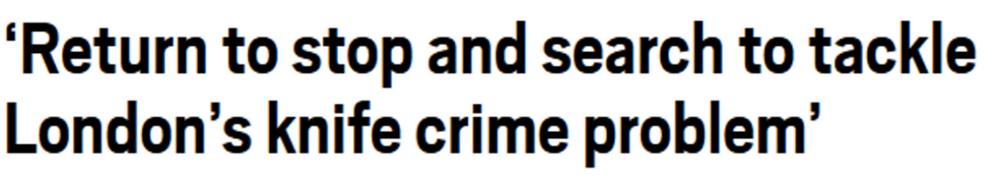
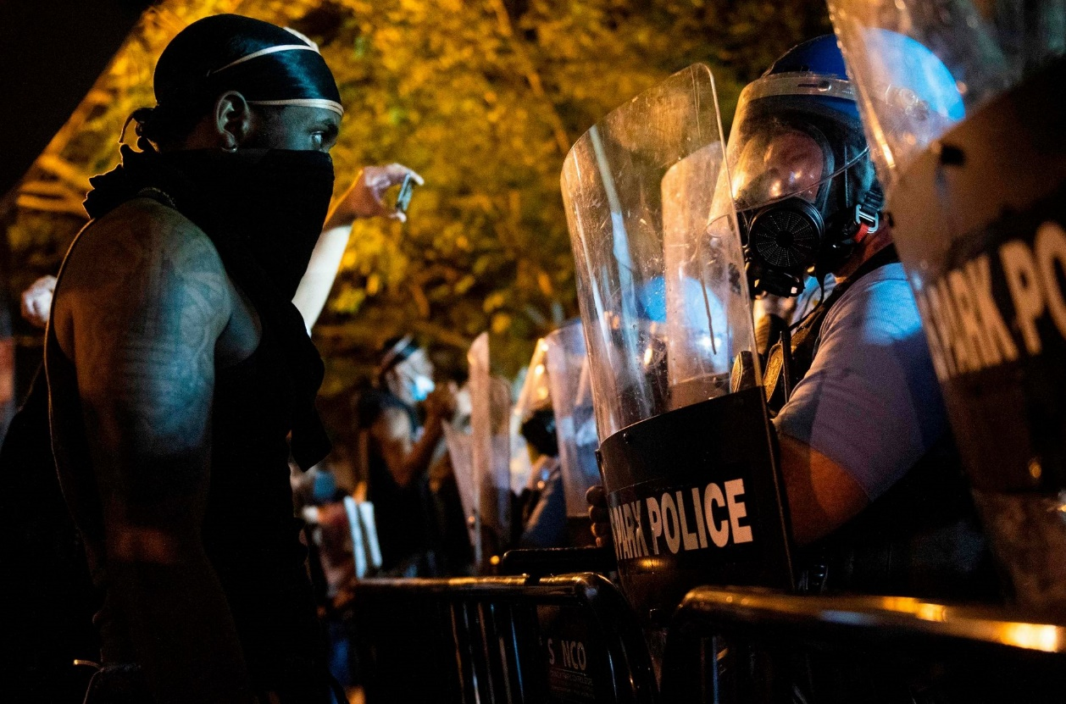
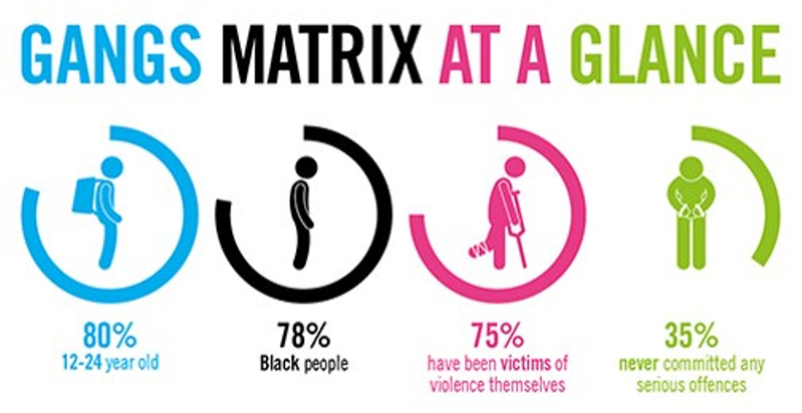
Social
Injustice
Photographer: Andrew Caballero-Reynolds | AFP via Getty Images

Slide 9

Shame
  What do you want so badly that you are willing to give up everything else in order to get it?" …"Pride. Dignity. Self-esteem." ….and then, speaking more in his usual manner, he added "And I'll kill every motherfucker in that cell block if I have to in order to get it."
James Gilligan
Shame, Guilt and Violence
https://dilipsimeon.blogspot.com/2013/03/james-gilligan-on-shame-guilt-and.html

Slide 10
Isolation
Strong, durable connections to others – particularly those who have our short – and long-term interest at heart – reduce the likelihood that we will commit violence
Key Concepts: Resilience
Harvard University

Slide 11
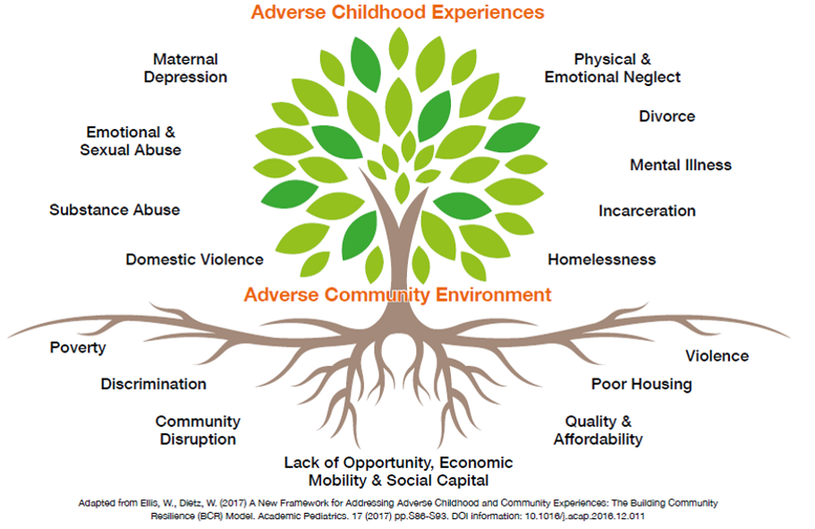
ACES
  Adverse Childhood Experiences
  &
  Adverse Community Environment

Slide 12

My Questions to You
I have spoken at length about the drivers of violence, yet often funding is linked to the symptoms – how can this change?
What role do we all have in changing the narrative around young Londoners?
Its important that we have clarity around specialist services and youth service – how do we ensure this?

Slide 13


Sherry Peck
CEO
sherrylynpeck@saferlondon.org.uk
www.saferlondon.org.uk
Any
Questions for me?

Slide 14
Reading List
Violence:
Violence: Reflections on a National Epidemic, James Gilligan
Preventing Violence, James Gilligan
Inequality:
The Spirit Level: Why More Equal Societies Almost Always Do Better (PDF below), Richard Wilkinson and Kate Pickett
http://emilkirkegaard.dk/en/wp-content/uploads/The-Spirit-Level-Why-Greater-Equality-Makes-Societies-Stronger-Kate-Pickett-400p_1608193411.pdf
Aces:
  The Deepest Well: Healing the Long-Term Effects of Childhood Adversity, Nadine Burke Harris
Establishment of Scottish VRU:
  Conviction: Violence, Culture and a Shared Public Service Agenda, John Carnochan
Trauma:
  The Body Keeps the Score: Brain, Mind, and Body in the Healing of Trauma, Bessel van see Kolk
  The Boy Who Was Raised as a Dog: And Other Stories from a Child Psychiatrist’s Notebook – What Traumatized Children Can Teach Us About Loss, Love, and Healing, Bruce D. Perry
Restorative Justice:
  Until We Reckon, Danielle Sered
Race:
White Fragility: Why It’s So Hard for White People to Talk About Racism, Robin DiAngelo
Contextual Safeguarding:
https://www.contextualsafeguarding.org.uk/
And… Dr Firmin’s excellent book:
Abuse Between Young People: A Contextual Account (Adolescence and Society), Carlene Firmin

